Slide 1


AI for VOCs detection
27/06/2024
Student: Maxime Wissocq
Internship tutor: Romuald Jolivot
University tutor: Barthélémy Heyrman
1

Slide 2
Table of contents
Introduction
Work progress
Future work
Conclusion
2

Slide 3




Volatile organic compounds
Introduction
Develop a system to quantify VOC using AI
Acquisition system
3

Slide 4
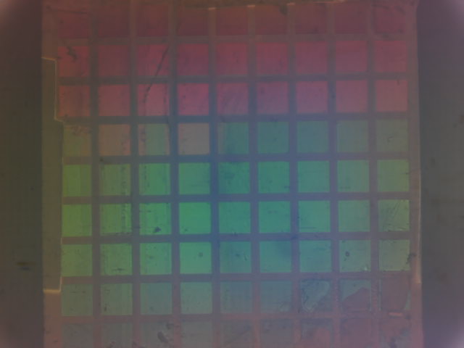


Presentation of the subject
Matrix of sensors
Image acquisition
Sensors data
VOC detected!
https://datascientest.com/
Image/Signal processing
4

Slide 5
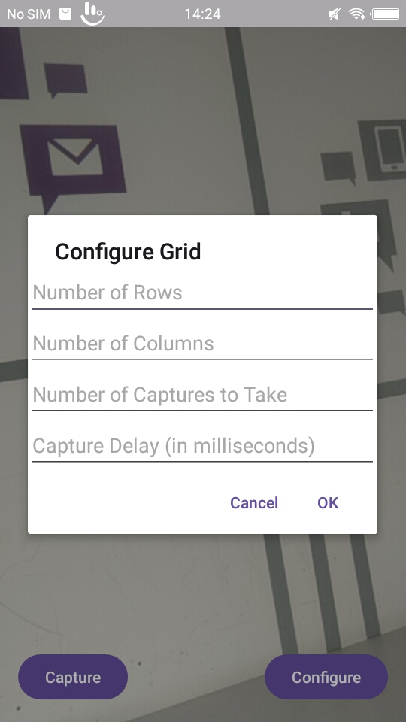
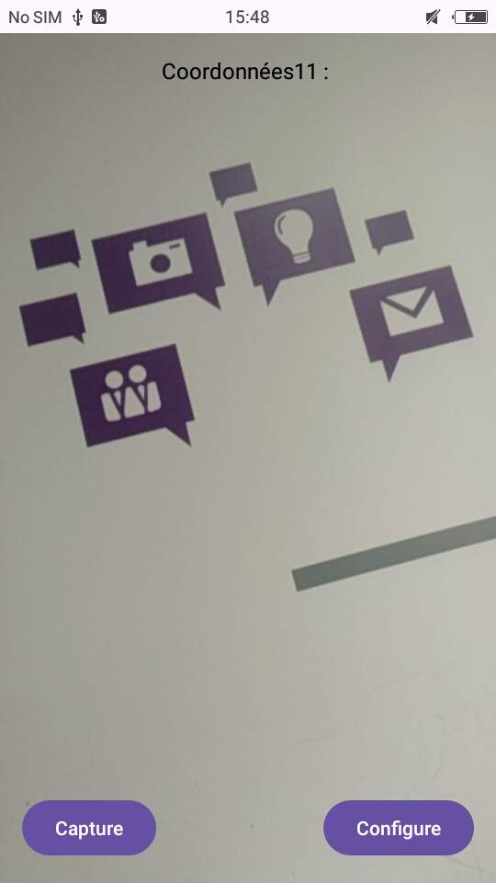
Feature #1: Image acquisition
Takes picture(s) by clicking
Set the number of pictures and the delay between each picture (timelapse)
5

Slide 6
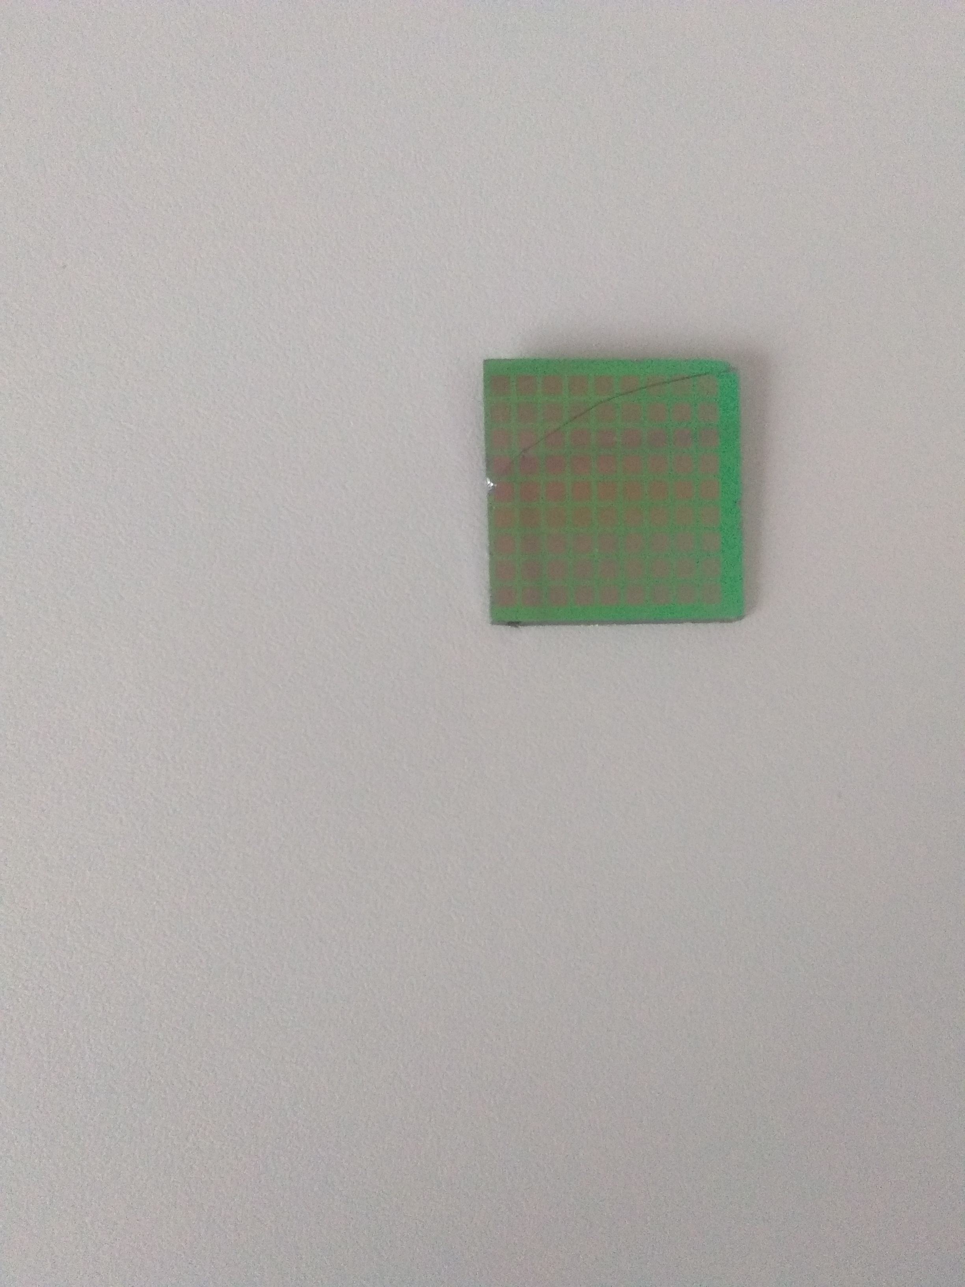
Feature #2: sensor detection
Captured Image
6

Slide 7
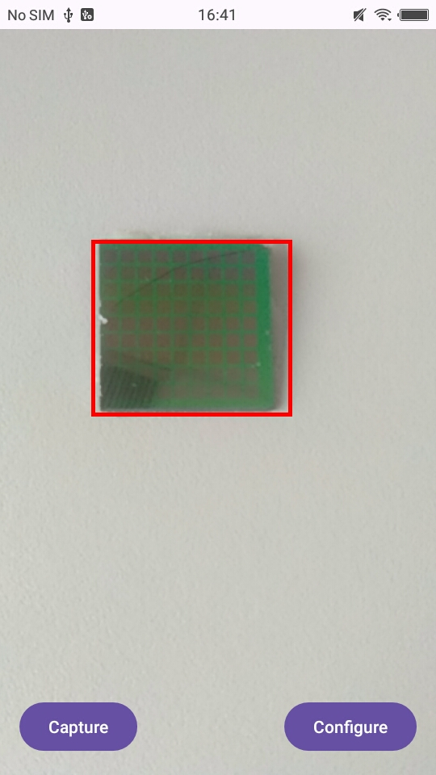
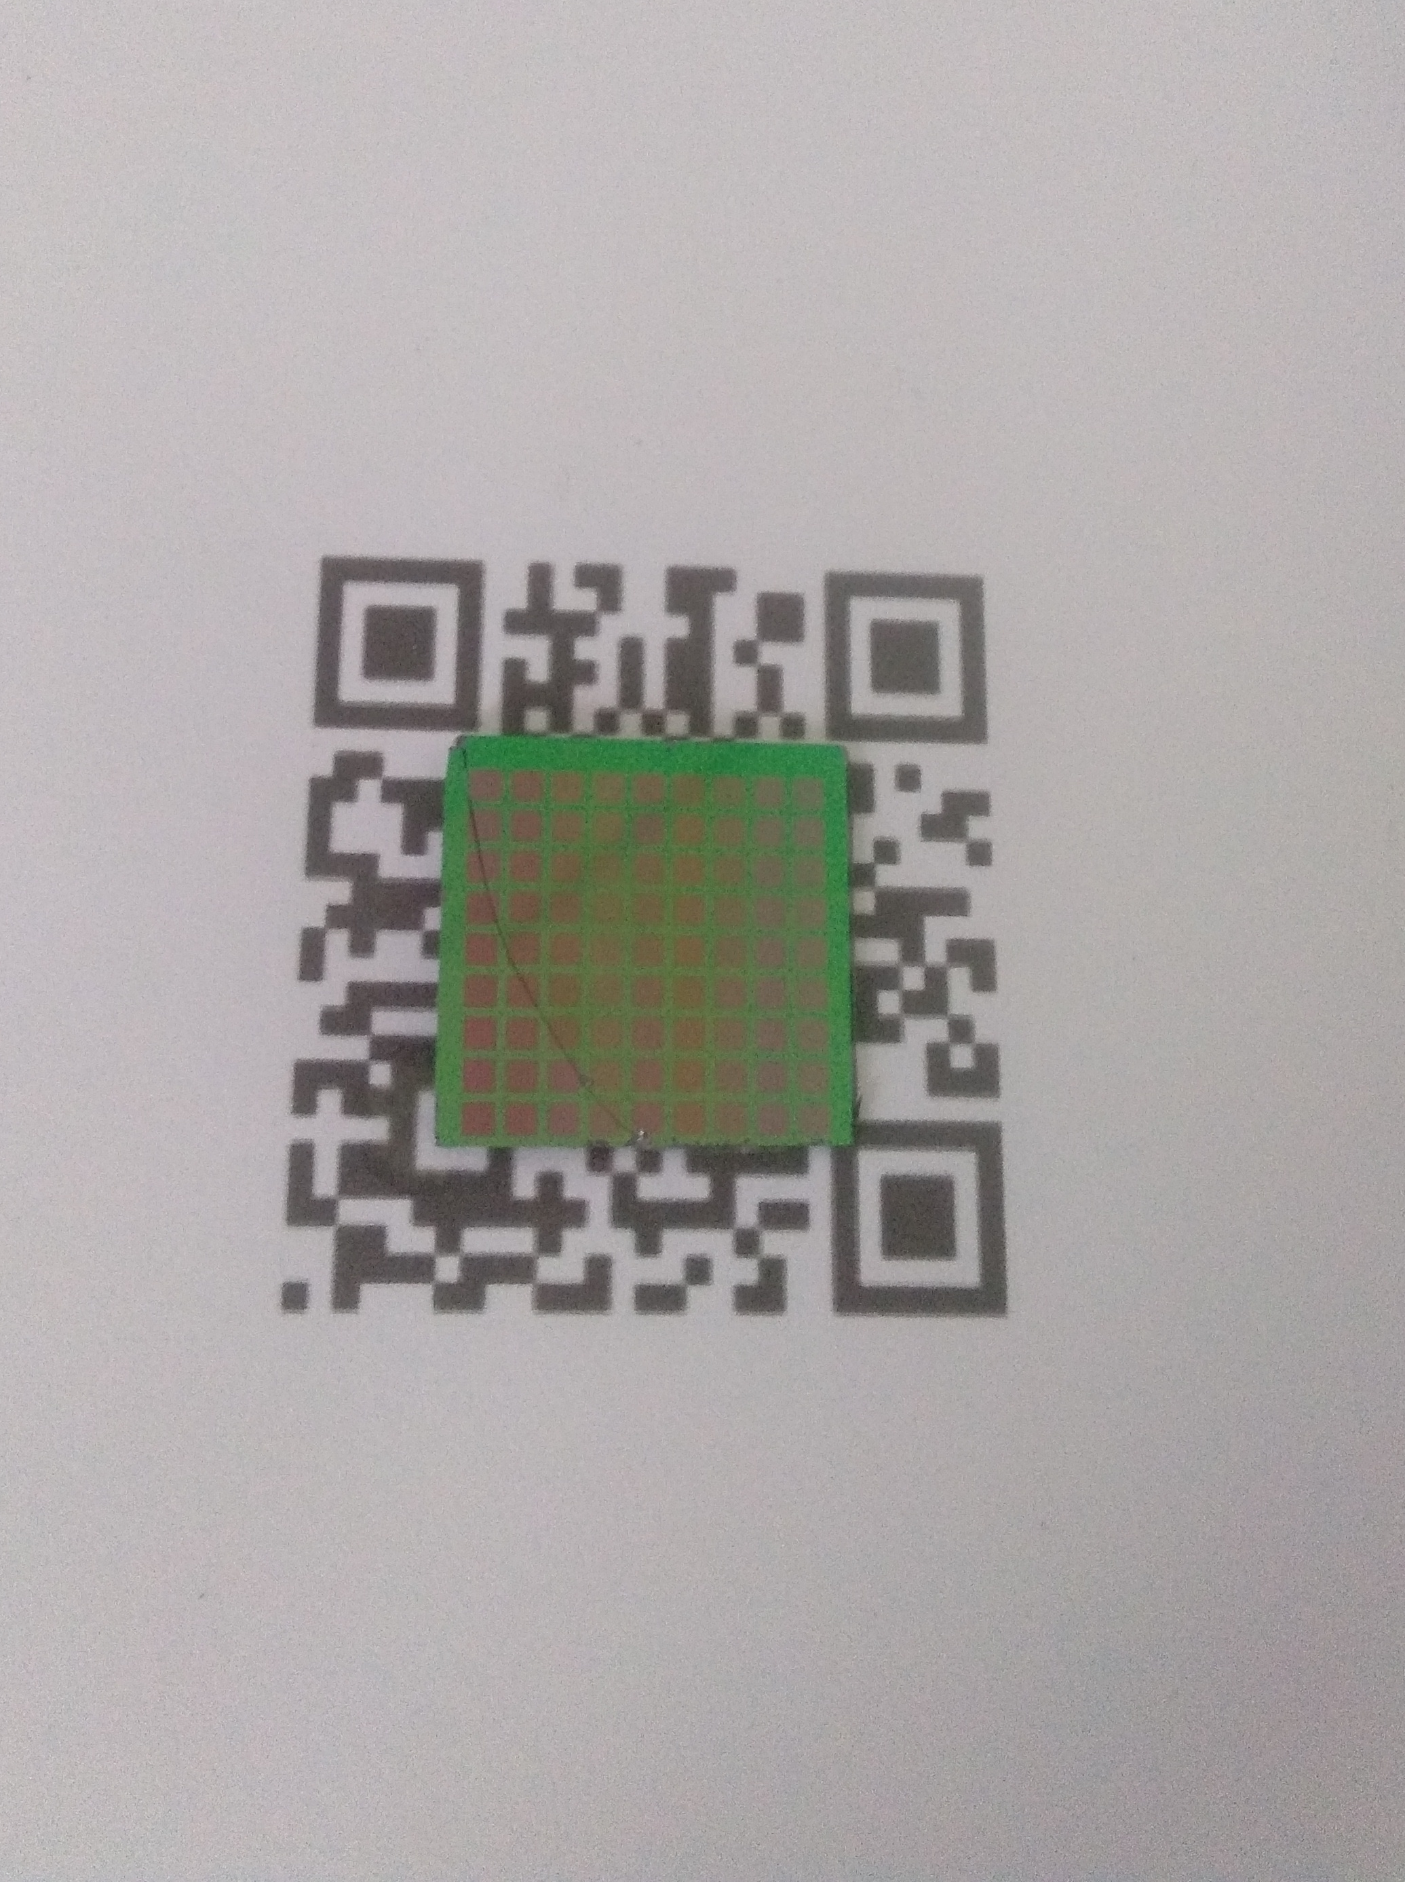
Feature #2: sensor detection
Selection using QR code finder pattern
Manual selection
7

Slide 8
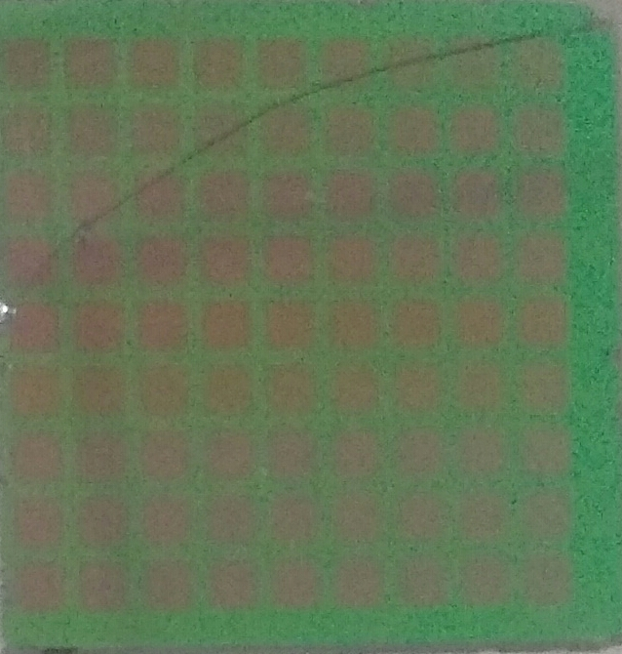
Feature #2: sensor detection
Thresholding
After the removal of high value pixels
RGB (200,200,200)
8

Slide 9
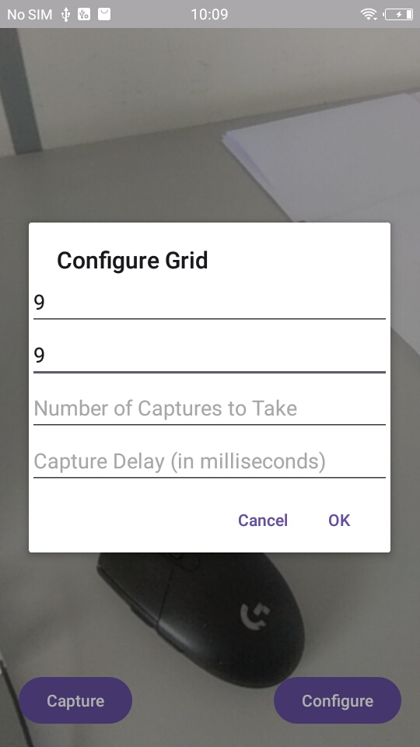
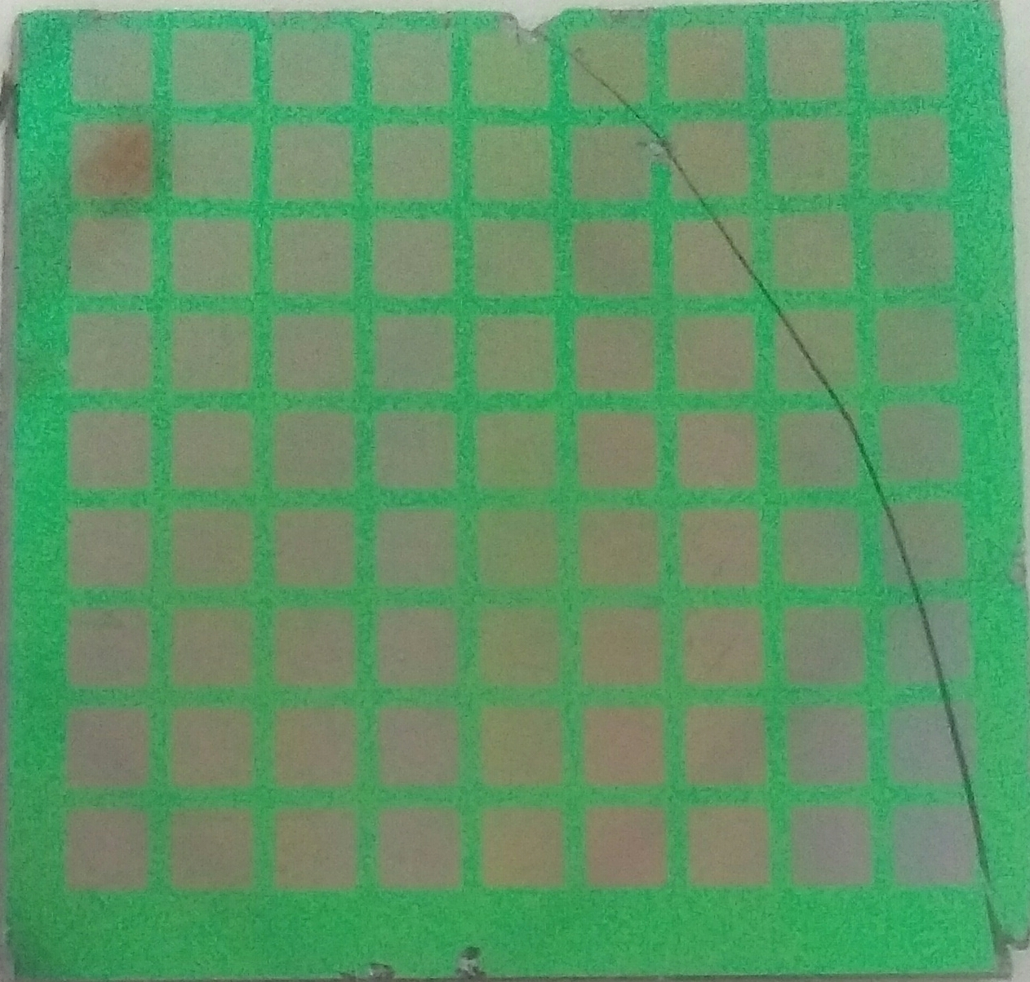

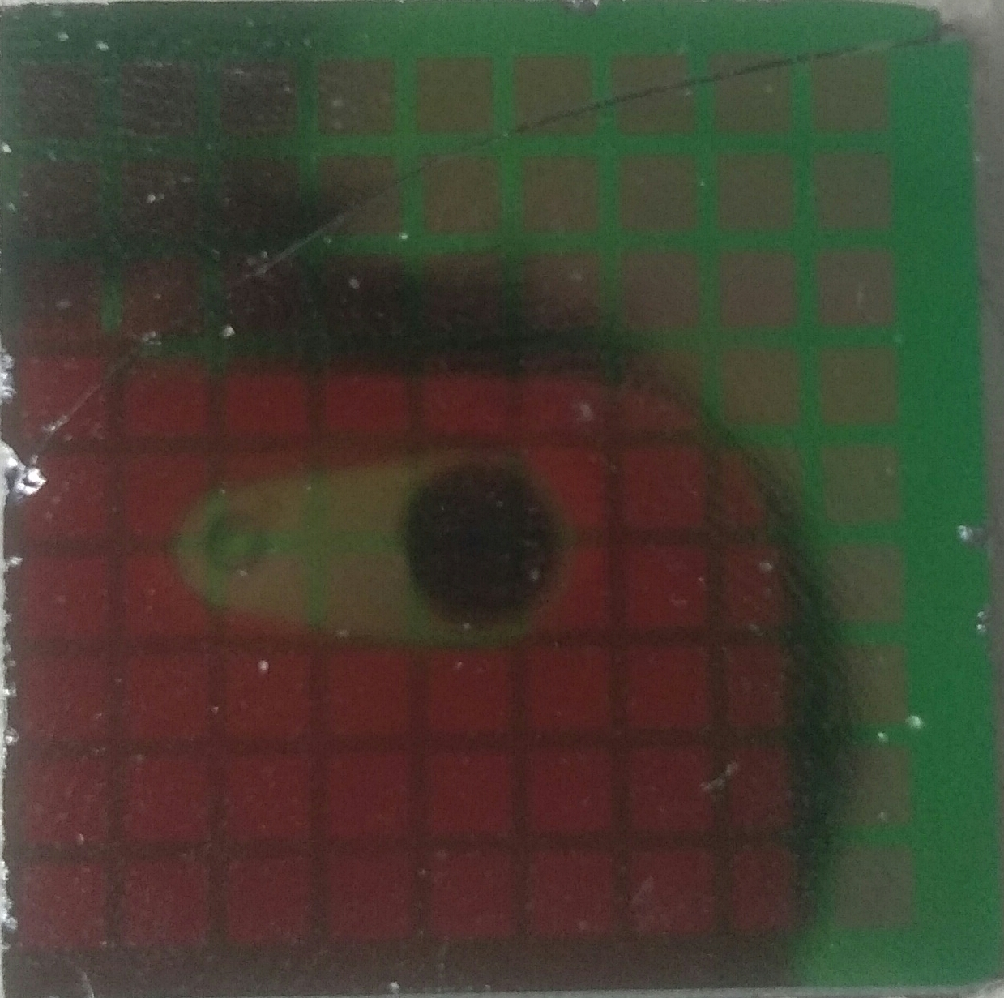
Feature #3: data extraction
One of the 81 sensors
Division into 81 individual sensors
Average RGB values calculated in the center of this sensor
9

Slide 10
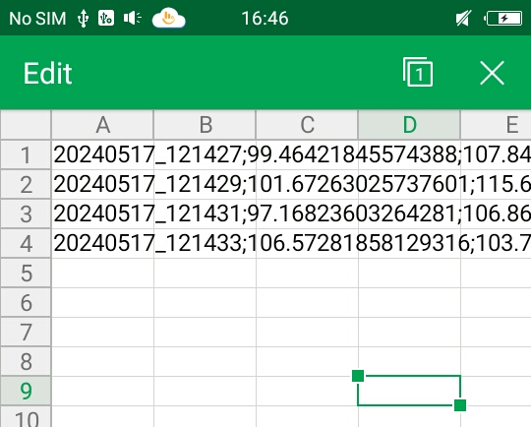
Feature #4: data recording
CSV file for 4 captures with a 2 seconds delay
Acquisition time
Average RBG values for each sensor extracted from the image
10

Slide 11
Future works
Implementation of data processing techniques
Design classication algorithms capable of identifying VOC
11

Slide 12
Conclusion
Developed an acquisition system
Implement VOC recognition using AI (to be done)
Thoughts on the internship so far
12

Slide 13
Thanks for listening
13

